Slide 1
To Be or Not To Be
that is a difficult decision!

Slide 2
Decisions are everywhere!
Which school should I go to?
Which company should I work for?
Which city should I live in?
Should I go study abroad?
Which class should I take?
Should I go to grad school?
Should I marry my girlfriend/boyfriend?
I am indecisive. So are many of my friends.

Slide 3
Decisions are difficult!
There are so much to consider and weigh
i.e. Which job to take?
Salary, location, team, project, friends, perks, company growth, personal growth…
How do people normally deal with these important decisions?
Listing pros and cons, talking to other people, wait until the last minute…

Slide 4
A Decision Making App

Slide 5
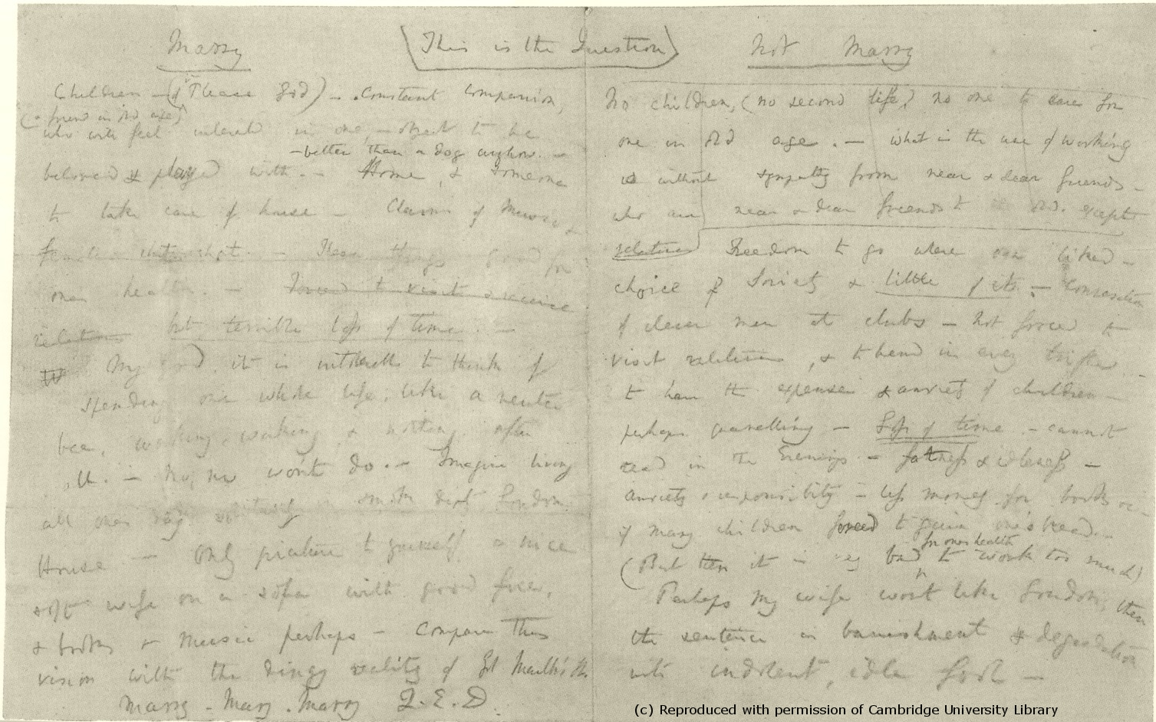
Pros and Cons
The most intuitive way to approach a decision¹
Marry. Marry. Marry. Q.E.D.
Notes:
1. Bonnefon, Jean-François (08/2008). "Qualitative Heuristics For Balancing the Pros and Cons". Theory and decision (0040-5833), 65 (1), p. 71.

Slide 6
Pairwise Comparison
The goal is to quantify how important each pro and con is to the decision maker
It is conceptually and practically hard to just give a value
Pairwise Comparison
Breaks the multi-dimension decision into many one-dimension questions
Captures relative importance between two factors
The more comparisons, the more complete the importance network it is
1
1
2
2
Notes:
Hansen, Paul; Ombler, Franz (2008). "A new method for scoring additive multi-attribute value models using pairwise rankings of alternatives". Journal of Multi-Criteria Decision Analysis 15 (3–4): 87. doi:10.1002/mcda.428

Slide 7
Network Scoring
Each factor is a node and the comparisons are the edges that connect the nodes. Weights are shifted between factors through comparisons.
Similar to PageRank: a factor gets more weight when it wins a comparison with an important factor than with a trivial one.
60
40
A
B
30
70
C
Notes:
Hansen, Paul; Ombler, Franz (2008). "A new method for scoring additive multi-attribute value models using pairwise rankings of alternatives". Journal of Multi-Criteria Decision Analysis 15 (3–4): 87. doi:10.1002/mcda.428

Slide 8
Points for this Comparison
Points for this factor
in this Comparison
Total Points
10*40/110*40/100 = 1.45
0
10
4.09 10
60
0
10
2.18 10
40
1.45
10
3.22
10
40
30
60
0
10
0
10
2.67
10
7.23
10
5.45
10
4.45
10
70
50
50
Notes:
float temp = factorA.score*(factorBScore/factorA.totalContribution);
// factor B gets a portion
factorB.tempScore += (factorBScore/100)*temp;
// factor A keeps the rest
factorA.tempScore+=(1-factorBScore/100)*temp;
// for normalization later: denominator
bd+= (factorBScore/100)*temp;
ad+=(1-factorBScore/100)*temp;

Slide 9
After Converging…
+2
+3
7.09 10
4.09 10
60
3.22
10
8.21510
40
5.22
10
0
8.215
7.22
10
60
30
40
0
7.22
5.63
5.48
+1.125
30
40
40
+2.625
70
14.9
13.8
70
0
12.98
0
11.58
7.23
10
9.855
10
5.45
10
12.98
10
11.58
10
8.45
10
60
60
+3.125
50
50
50
50
Notes:
float temp = factorA.score*(factorBScore/factorA.totalContribution);
// factor B gets a portion
factorB.tempScore += (factorBScore/100)*temp;
// factor A keeps the rest
factorA.tempScore+=(1-factorBScore/100)*temp;
// for normalization later: denominator
bd+= (factorBScore/100)*temp;
ad+=(1-factorBScore/100)*temp;

Slide 10
User Testing
In progress: 8 participants and counting
Goal:
Is this app actually helpful for decision makers?
How people make decisions?
Feedback for improvement!
Evaluation Procedure:
Make a decision without the app, rate the difficulty and the confidence level about this decision
Make the same decision with the app, rate the confidence level again
Follow up questions

Slide 11
Result
8/8
Will Use It
6.42/10
Trust
31.4% ⬆
Confidence

Slide 12
What they say…
The ranking of the factors is really helpful!
This is very interesting!
This app is useful when I have really done the research and know all the factors
This app makes me think more about my decision.
Some first-timer tips and guidance will be helpful.
I thought it would be like one of those BuzzFeed quizzes…

Slide 13
Interesting…
No matter how indecisive they say they are, people rarely feel regret about their past decisions
When the result contradicts with their prior beliefs, some people try to fix it by refining the Pros & Cons, others find themselves actually influenced by the result.
The quality and completeness of the Pros and Cons are really important to accuracy.

Slide 14
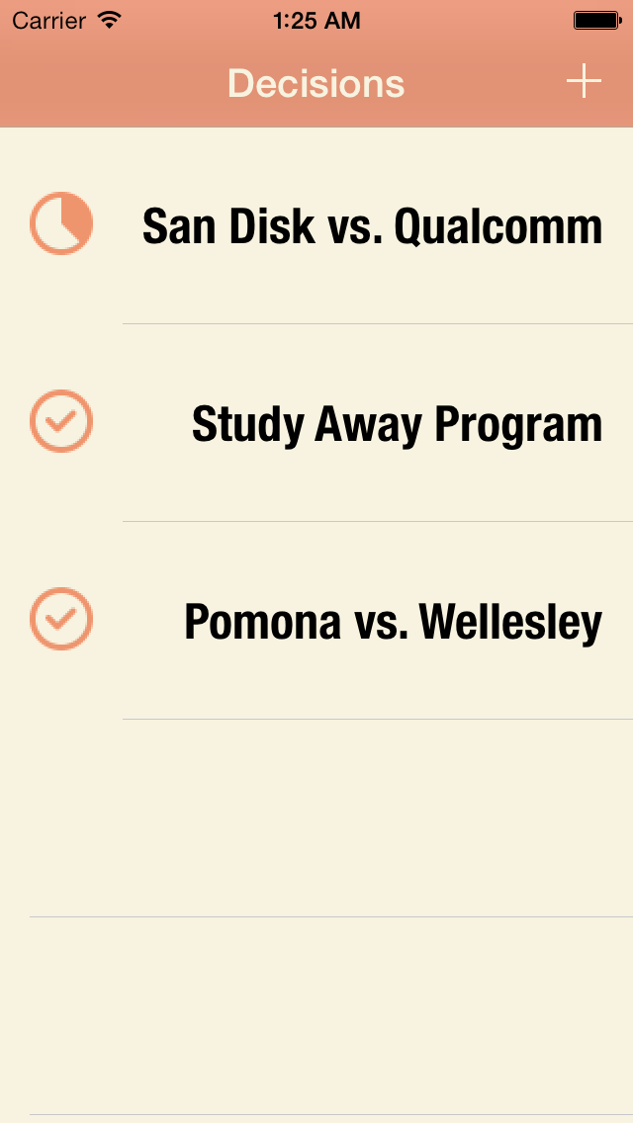
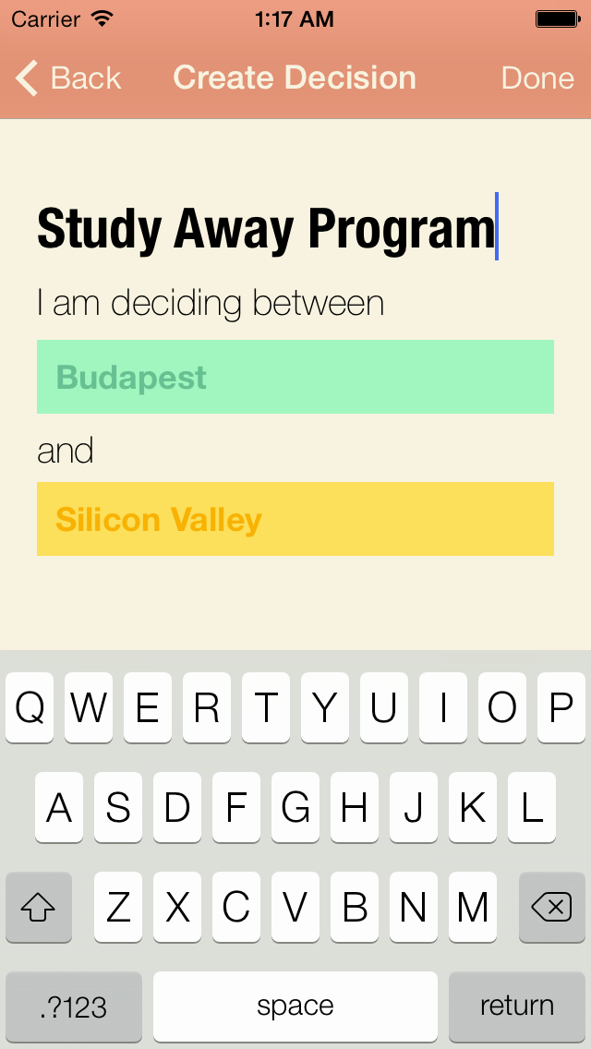
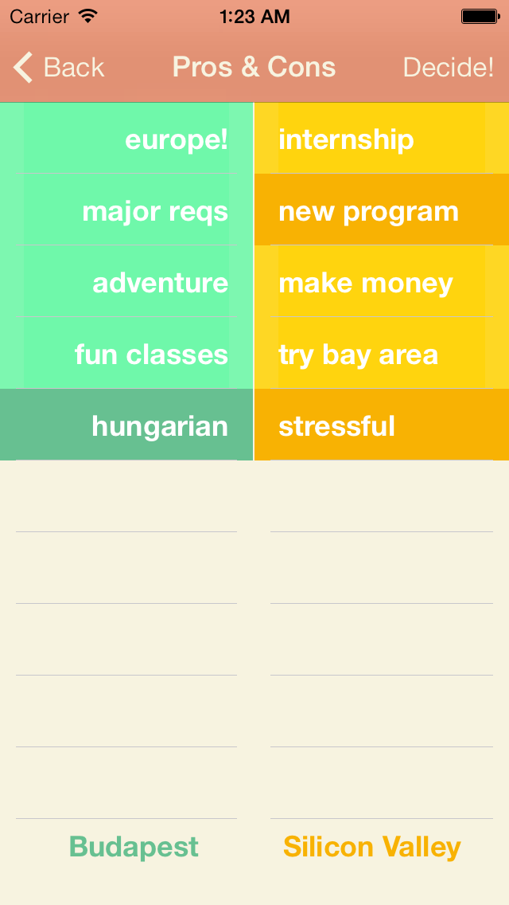
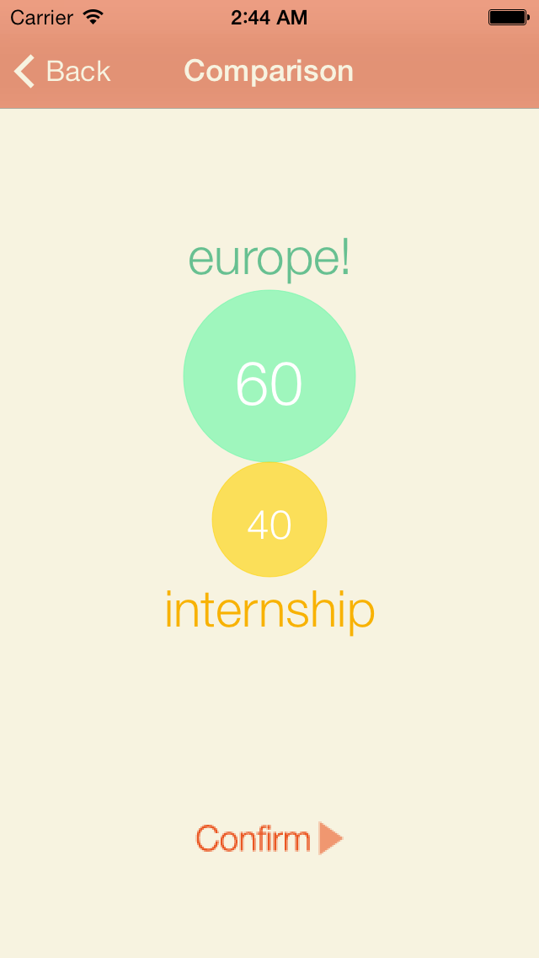
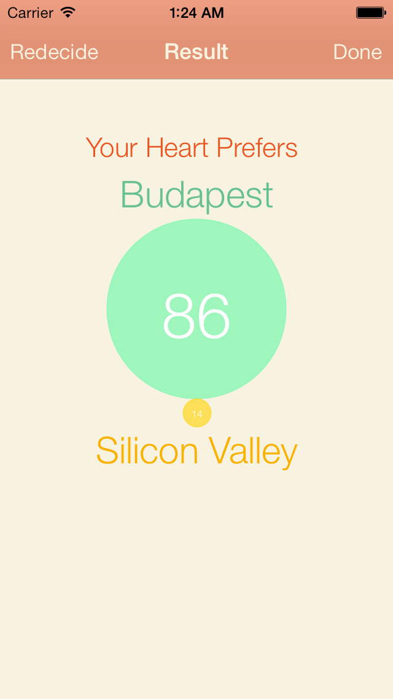
Thank you!

